Slide 1
LOAN MANAGEMENT SYSTEM
DATABASE MANAGEMENT SYSTEM
Group A
LUKYAMUZI MUGAGGA PROSPER 2025/BCS/213/PS

Slide 2
PRESENTATION OUTLINE
Business Case
System Overview
Logical Design
01
02
03
Why a Loan Management System?
Domain, users & key features
Entities, attributes & relationships
ERD
Physical Design
Sample Queries
04
05
06
Entity Relationship Diagram
MySQL schema & table structure
SQL queries & results

Slide 3
BUSINESS CASE
WHY THIS SYSTEM?
TANGIBLE BENEFITS
Manual loan processing is slow, error-prone and hard to track. Banks need:
Automated loan application workflow
Real-time repayment tracking
Centralized customer credit records
Audit trail for regulatory compliance
Faster loan approval decisions
60% reduction in processing time
Reduced default rate via risk scoring
Increased loan portfolio capacity
RISKS & LIMITATIONS
Staff training required (intangible cost)
Initial setup & hardware investment
Data migration from legacy systems
Limited multi-currency support (v1)

Slide 4
SYSTEM OVERVIEW
Customer Module
Loan Application
Approval Workflow
Repayment Module
Customer registration & KYC
Online application form
Risk assessment engine
Payment scheduling
Credit history lookup
Document upload
Officer review & decision
Installment tracking
Late payment penalties
Customer profile management
Application status tracking
Multi-tier authorization

Slide 5
LOGICAL DESIGN — ENTITIES & ATTRIBUTES
CUSTOMER
LOAN
PAYMENT
EMPLOYEE
Customer_ID (PK)
Loan_ID (PK)
Payment_ID (PK)
Employee_ID (PK)
FirstName
CustomerID (FK)
LoanID (FK)
FullName
LastName
LoanType
DueDate
Branch
NationalID
PrincipalAmount
AmountDue
Role
Phone
InterestRate
AmountPaid
Email
Email
StartDate
PaymentDate
Address
EndDate
PenaltyFee
CreditScore
Status

Slide 6
ENTITY RELATIONSHIP DIAGRAM
CUSTOMER
LOAN
EMPLOYEE
PK | Customer_id INT)
 | name(VARCHAR) phone(VARCHAR) address(VARCHAR) region(VARCHAR)
PK | Loan_id(INT)
 | Customer _id(INT) FK Employee_id(INT) FK Loan _amount(DECIMAL) Interest_rate(DECIMAL) Start_date(DATE) Due_date(DATE) Status(VARCHAR)
PK | employee_id(INT)
 | name(VARCHAR) position(VARCHAR)
applies 1:M
reviews1:M
>
<
>
has 1:M
PAYMENT
PK | payment_id(INT)
 | loan_id(INT) FK amount_paid(DECIMAL) payment_date(DATE) payment_method(VARCHAR)

Slide 7
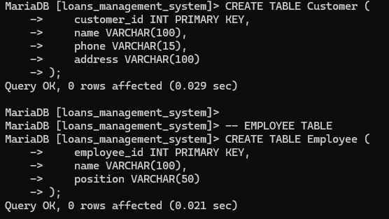
PHYSICAL DESIGN — MySQL SCHEMA

Slide 8
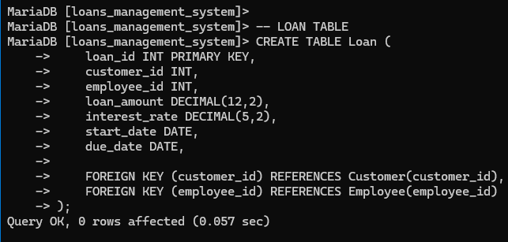
PHYSICAL DESIGN — MySQL SCHEMA

Slide 9
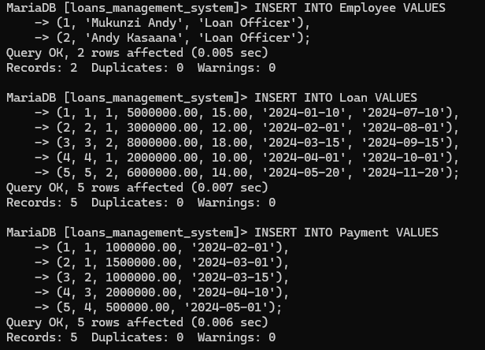
PHYSICAL DESIGN — MySQL SCHEMA

Slide 10
SAMPLE SQL QUERIES & RESULTS
Query 1 — All Active Loans
Result:
SELECT c.FullName, l.LoanID, l.Principal, l.Status
FROM Customer c JOIN Loan l ON c.CustomerID = l.CustomerID
WHERE l.Status = 'Active';
Returns all customers with active loans and their amounts
Query 2 — Overdue Repayments
Result:
SELECT l.LoanID, r.DueDate, r.AmountDue, r.AmountPaid
FROM Repayment r JOIN Loan l ON r.LoanID = l.LoanID
WHERE r.DueDate < CURDATE() AND r.AmountPaid < r.AmountDue;
Identifies all loans with missed or partial payments
Query 3 — Total Loans by Officer
Result:
SELECT o.FullName, COUNT(l.LoanID) AS TotalLoans
FROM Officer o JOIN Loan l ON o.OfficerID = l.OfficerID
GROUP BY o.FullName ORDER BY TotalLoans DESC;
Shows each officer's loan processing count

Slide 11
SYSTEM IMPLEMENTATION
[ Screenshot: MySQL Workbench — Table Structure ]
[ Screenshot: MySQL Workbench — Query Results ]
MySQL Workbench — Table Structure
MySQL Workbench — Query Results
[ Screenshot: Database Schema (Relationships View) ]
[ Screenshot: Sample Data — Customer Table ]
Database Schema (Relationships View)
Sample Data — Customer Table

Slide 12
KEY TAKEAWAYS
The Loan Management System
delivers real banking value
✓ Fully normalized MySQL relational database
✓ Covers the complete loan lifecycle end-to-end
✓ Supports key banking user groups
✓ Scalable design ready for production deployment
Thank you! Questions? | GitHub: [your-username]/loan-management-system

